Slide 1


K.RAMAKRISHNAN COLLEGE OF ENGINEERING
(AUTONOMOUS), SAMAYAPURAM - TRICHY DEPARTMENT OF CSE
CGB1201 – JAVA PROGRAMMING
END SEMESTER PROJECT REVIEW DECEMBER 2024
EXPENSE TRACKER
PRESENTED BY SUPERVISOR
K. KRISHKANTH Mrs.S.Saranya M.E., (Ph.D.,),
8115U23CS051 Assistant Professor/CSE.

Slide 2
PRESENTATION OVERVIEW
Project Introduction
Objective
Problem Statement
Java Concepts
Modules Used
Architecture Diagram
Merits and Demerits
Program Execution and Output
Queries

Slide 3
PROJECT INTRODUCTION
The Expense Tracker Application helps users manage their finances by tracking income and expenses across categories. It provides real-time budget insights, alerts for overspending, and a summary of expenses. Built with Java Swing, it aims to help users stay within their budget and manage money effectively.

Slide 4
OBJECTIVE
To help users manage monthly finances by tracking income, expenses, and providing budget insights for effective money management.

Slide 5
PROBLEM STATEMENT
Many individuals struggle to track their expenses and manage their budget effectively, leading to overspending. There is a need for an easy-to-use tool that helps users monitor their income, categorize expenses, and stay within their financial limits.

Slide 6
JAVA CONCEPTS
Swings
Event Handling
Layout Management
Data Types
Exception Handling
KeyListener

Slide 7
MODULES USED
Add Monthly Salary
Allows the user to input their total monthly income.
Add Expenses
Enables users to input and track expenses across various categories (grocery, entertainment, etc.).

Slide 8
MODULES USED
Summary
Displays a summary of income, expenses, and the remaining balance.
Check Budget Insights
Provides feedback on whether expenses exceed the set budget limits and suggests adjustments.

Slide 9
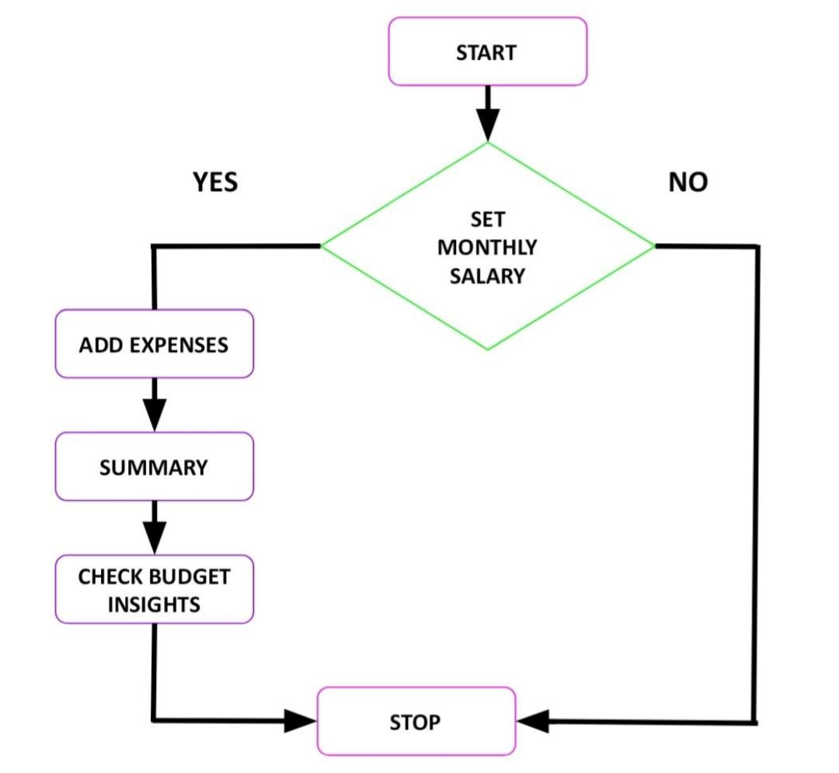
ARCHITECTURE DIAGRAM

Slide 10
MERITS
Cross-platform compatibility
Rich GUI libraries
Strong exception handling
Large community support
Scalability for future extensions

Slide 11
DEMERITS
Verbosity in code
Outdated GUI libraries
Higher memory usage
Performance overhead due to JVM
Not ideal for web applications

Slide 12
EXECUTION
When the program starts, the GUI is initialized and the main menu is displayed. User interactions trigger updates for salary, expenses, and budget insights.

Slide 13
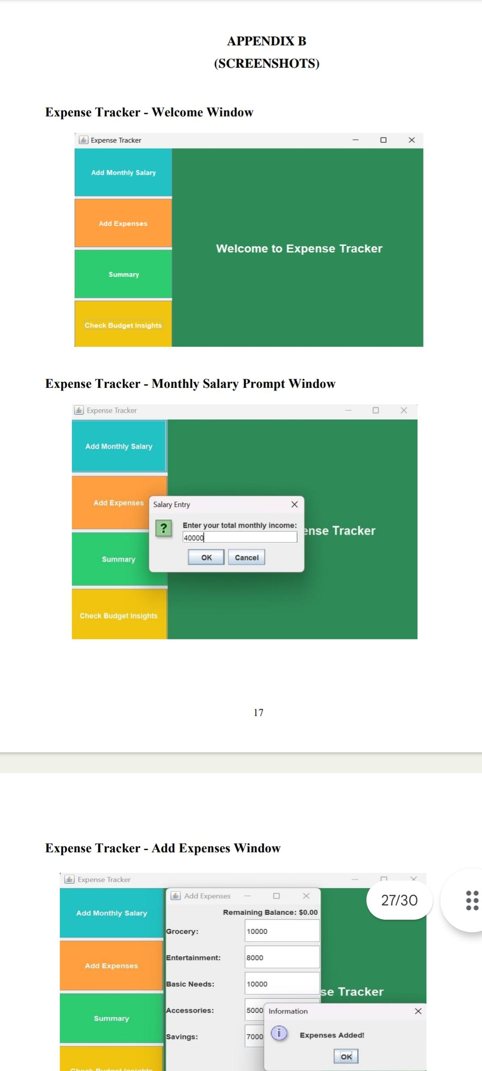
OUTPUT

Slide 14
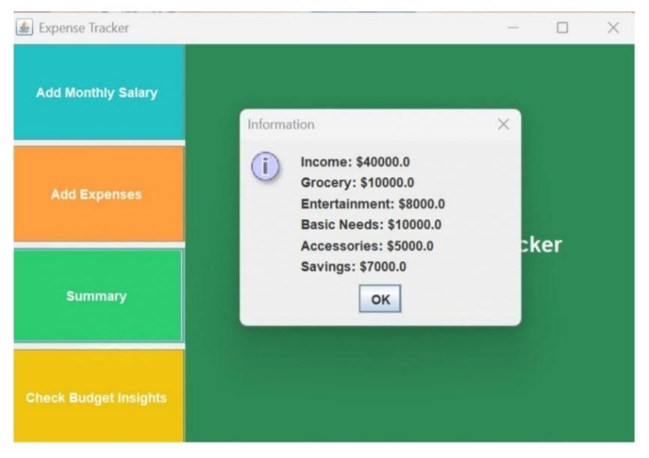
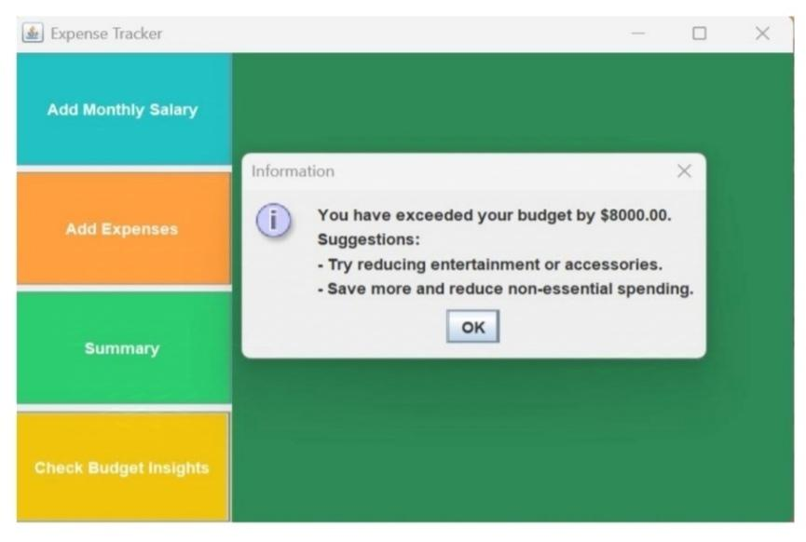
OUTPUT

Slide 15

QUERIES

